Slide 1

YOU
HAVE HELPED BRING NEW TREATMENTS
FORWARD
Notes:
You have helped bring new treatments forward.
Your efforts, your commitment, your dedication have all helped our kids with NMD.
You have put forth the hard work in the community to raise awareness of NMD.
You have put forth the hard work to raise money to advance the science and technology that are bringing to the forefront new innovative treatments for our patients with NMD.
You have put forth the hard work to help us for 65 incredible years.
And for this on your anniversary, we humbly say thank you.
You have help bring new treatments forward..

Slide 2
The IAFF
For more than 60 years, Fire Fighters have mobilized communities in support of MDA
Established in 1954
1,655 fill the boot events
>100,000 volunteer participants
Millions of dollars raised every year
2
Notes:
So let’s take a look at this effort…
For more than 60 years, the IAFF has been engaged and mobilized with over 1,655 Fill the Boot events (IS THIS ANNUALLY OR IN TOTAL?)
You represent over 100,000 volunteers
And you have raised millions of dollars and you continue to raise millions of dollars every year.

Slide 3
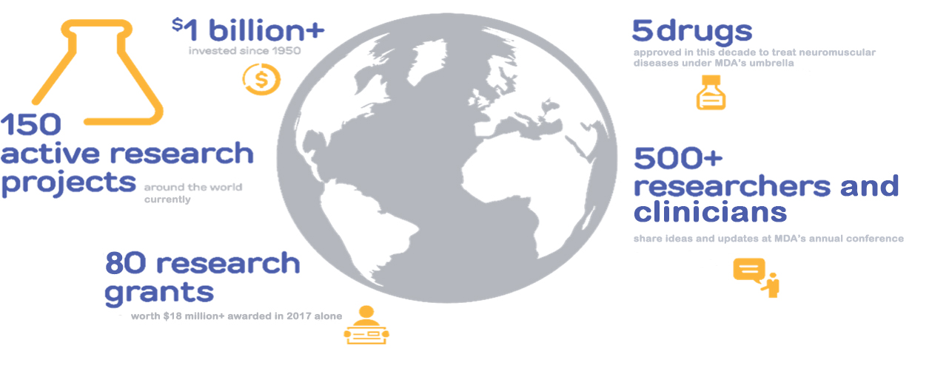
Those Dollars Have Been Invested…
Notes:
So let’s take a look at how those dollars have been invested…
Your contributions have helped fund over 150 active research projects, worldwide
Your contributions have allowed us to award over 70 research grants
Your contributions help us to host every year our annual conference.
In fact we just held our annual clinical conference to a sell out crowd of over 700 top researchers, academicians, clinicians and physicians.
It was our largest conference ever and next year we are going even bigger…expecting to double in size the number of participants.
We are super excited about this.
But most important…we have new treatments available. The investment in science and research are finally paying off. We are seeing new treatments become available.
Again, you helped us bring all of this forward.

Slide 4
And Look… Where We Are Now
Record number of clinical trials underway
New national MDA Resource Center opens with 800 number and online resources
Notes:
And so, let’s look at where we are now…
We have a record number of clinical trials underway. In fact, today there are more than 90 treatments in the clinical development pipeline. That means 90 drugs and therapies in Phase I, II, or III clinicals trials. It’s the most that we have ever had in clinical development and the number is growing.
Second, the FDA is granting accelerated approval for certain NMD drugs – which means certain drugs can get to patients faster recognizing how critical time is for our patients.
And, we are seeing some of our first disease modifying drugs come to market. These drugs go beyond treating symptoms and actually change the course of the disease with some of them having a promise for a cure.
Third, our efforts to embrace multi-disciplinary patient care is taking hold in over 150 Care Centers around the United States.
Look at all this good work…
Our summer camps continue to serve close to 4000 kids each year; where these kids have the chance to learn important life skills and learn how to live more independently. I know a lot of you here volunteer at camp. It’s an amazing experience for kid and counselor alike. Our kids tell us it’s the best week of their year. Parents and volunteers tell us that too.
We’ve opened a national resource center staffed by individuals affected by our diseases. We are seeing more than 10K calls and inquires to this resource center each year.
Finally, your efforts have helped us be recognized and honored within the Smithsonian as part of their exhibit on Philanthropy and Giving.
And if this is not enough…

Slide 5
And Look… Where We Are Now
Annual MDA summer camp sessions serving 3,800 kids each year
The Smithsonian Museum of History features MDA as part of the History of Philanthropy and Giving exhibit
Notes:
And so, let’s look at where we are now…
We have a record number of clinical trials underway. In fact, today there are more than 90 treatments in the clinical development pipeline. That means 90 drugs and therapies in Phase I, II, or III clinicals trials. It’s the most that we have ever had in clinical development and the number is growing.
Second, the FDA is granting accelerated approval for certain NMD drugs – which means certain drugs can get to patients faster recognizing how critical time is for our patients.
And, we are seeing some of our first disease modifying drugs come to market. These drugs go beyond treating symptoms and actually change the course of the disease with some of them having a promise for a cure.
Third, our efforts to embrace multi-disciplinary patient care is taking hold in over 150 Care Centers around the United States.
Look at all this good work…
Our summer camps continue to serve close to 4000 kids each year; where these kids have the chance to learn important life skills and learn how to live more independently. I know a lot of you here volunteer at camp. It’s an amazing experience for kid and counselor alike. Our kids tell us it’s the best week of their year. Parents and volunteers tell us that too.
We’ve opened a national resource center staffed by individuals affected by our diseases. We are seeing more than 10K calls and inquires to this resource center each year.
Finally, your efforts have helped us be recognized and honored within the Smithsonian as part of their exhibit on Philanthropy and Giving.
And if this is not enough…

Slide 6
And Look… Where We Are Now
FDA is granting accelerated approval for certain NMD drugs
Adoption of multidisciplinary patient care in MDA’s 150 Care Centers
Notes:
And so, let’s look at where we are now…
We have a record number of clinical trials underway. In fact, today there are more than 90 treatments in the clinical development pipeline. That means 90 drugs and therapies in Phase I, II, or III clinicals trials. It’s the most that we have ever had in clinical development and the number is growing.
Second, the FDA is granting accelerated approval for certain NMD drugs – which means certain drugs can get to patients faster recognizing how critical time is for our patients.
And, we are seeing some of our first disease modifying drugs come to market. These drugs go beyond treating symptoms and actually change the course of the disease with some of them having a promise for a cure.
Third, our efforts to embrace multi-disciplinary patient care is taking hold in over 150 Care Centers around the United States.
Look at all this good work…
Our summer camps continue to serve close to 4000 kids each year; where these kids have the chance to learn important life skills and learn how to live more independently. I know a lot of you here volunteer at camp. It’s an amazing experience for kid and counselor alike. Our kids tell us it’s the best week of their year. Parents and volunteers tell us that too.
We’ve opened a national resource center staffed by individuals affected by our diseases. We are seeing more than 10K calls and inquires to this resource center each year.
Finally, your efforts have helped us be recognized and honored within the Smithsonian as part of their exhibit on Philanthropy and Giving.
And if this is not enough…

Slide 7

As Research Continues From Lab to Clinic We Will Be Ready…
First -ever comprehensive Data Hub - MOVR
A information technology platform to track natural history data, longitudinal health care outcomes, and genetic sequencing information
Full suite of medical education and medical communication resources
Up to date digital and collateral information for patients, physicians, care givers and families
Clinical Trial Ready Sites
To aid physicians and patients select and participate in important research as appropriate
Notes:
And as research continues, with your continued support, we will be ready.
We will be ready with the first ever comprehensive Data Hub – unique information technology platform to track patients’ natural history data, longitudinal healthcare outcomes, and genetic sequencing information.
We will be ready with a full suite of medical education and medical communication resources to help our patients and families understand courses of treatment and new drugs therapies.
We will help get clinical trial sites ready for more and more clinical trials. And we will help education patients and families about those clinicals trials.
So with your continued support, we will continue to be ready.
The first decade of the 21st century brought unprecedented progress for individuals living with neuromuscular disease. During this time innovative laboratory research started making its way in ever greater numbers to the clinic.
Dozens of clinical trials testing various therapies were conducted for ALS and Duchenne muscular dystrophy, including the first gene therapy trial for Duchenne.
Myozyme the first drug for Pompe disease was approved by the FDA greatly extending the lifespan and quality of life for these individuals.
Encouraging treatments for spinal muscular atrophy (SMA) started to be tested during this decade for the first time.
In 2007, MDA’s Advocacy Program was launched. This program allows MDA to effectively advocate for policies and programs that help save and improve the lives of kids and adults living with neuromuscular disease. Together, we ensure that our collective voice is heard by policy makers.

Slide 8
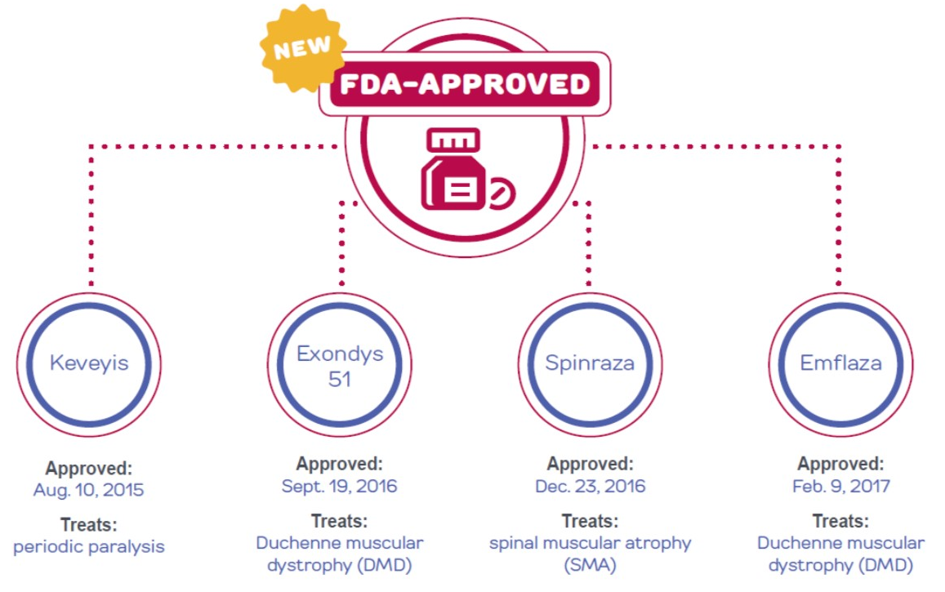



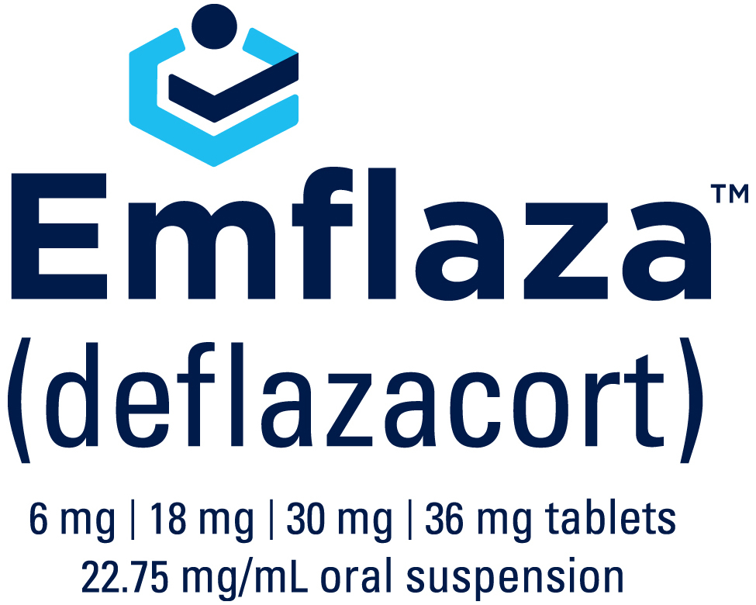
NEW Treatments
Notes:
And the new treatments they are here…
And they are here for a range of NMDs like Duchenne Muscular Dystrophy and Spinal Muscular Atrophy.

Slide 9


Other Recent FDA Approvals
Approved: May 5, 2017 Treats: Amyotrophic Lateral Sclerosis (ALS)
Approved: October 23, 2017 Treats: Generalized Myasthenia Gravis (gMG)
Notes:
And for diseases like ALS and Myasthenia Gravis.
Radacava is the first ALS treatment to be approved in the United States in more than 20 years, and is only the second drug ever approved to treat this devastating disease. Soliris is the first in a new class of drugs to be approved for people living with generalized MG. These drugs are not cures, but like the previous 4 mentioned, may lessen the symptoms experienced by those living with the diseases.

Slide 10
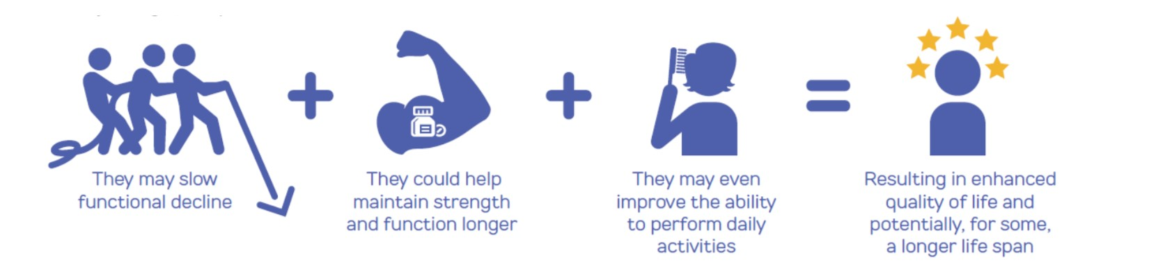
The Promise of the Pipeline Transforming and Saving Lives
Notes:
So in summary, these new drugs could provide significant benefits to individuals living with muscular dystrophy and related diseases. -They may slow functional decline -They could help maintain strength and function longer -They may even improve the ability to perform daily activities All of this results in enhanced quality of life and potentially, for some, a longer life span.
Which is really exciting…
So as I started our time together, thanking you for helping us bring new treatments forward.
I want to end our time together, thanking you for helping us not only bring new treatments forward but also for bring new experiences forward for our kids…kids who are now living longer and able to do more because of your hard work, dedication and effort.
On that note, I will end with our National Ambassador, who is living longer and experiencing more…all because of our collective effort together.

Slide 11
Virginia Fill the Boot Totals – As of September 25, 2018
L2068 - Fairfax County PFFA and Paramedics
L2068 - Fairfax County PFFA and Paramedics - $603,676
L2801 - Suffolk Professional Fire And Rescue - $60,000
L2598 - Prince William PFFA - $56,117
L2803 - Chesterfield County Professional Fire Fighters Assn - $53,778
L2141 – Alexandria - $40,000
L0068 – Norfolk - $38,000
L3194 – Roanoke County Fire & Rescue - $37,742
L1568 - Henrico County - $37,360
Notes:
You have helped bring new treatments forward.
Your efforts, your commitment, your dedication have all helped our kids with NMD.
You have put forth the hard work in the community to raise awareness of NMD.
You have put forth the hard work to raise money to advance the science and technology that are bringing to the forefront new innovative treatments for our patients with NMD.
You have put forth the hard work to help us for 65 incredible years.
And for this on your anniversary, we humbly say thank you.
You have help bring new treatments forward..

Slide 12
Virginia Fill the Boot Totals – As of September 25, 2018
L2068 - Fairfax County PFFA and Paramedics
L1146 - Lynchburg Fire Fighters Association - $33,337
L0995 – Richmond - $31,856
L3756 - Loudoun Career - $27,908
L3217 - Metropolitan Washington Airport Authority - $22,000
L0539 – Portsmouth - $21,213
L4202 – Hanover - $20,000
L3762 - Fauquier County - $17,500
L4012 - Stafford County - $14,000
L1132 – Roanoke - $12,050
Notes:
You have helped bring new treatments forward.
Your efforts, your commitment, your dedication have all helped our kids with NMD.
You have put forth the hard work in the community to raise awareness of NMD.
You have put forth the hard work to raise money to advance the science and technology that are bringing to the forefront new innovative treatments for our patients with NMD.
You have put forth the hard work to help us for 65 incredible years.
And for this on your anniversary, we humbly say thank you.
You have help bring new treatments forward..

Slide 13
Virginia Fill the Boot Totals – As of September 25, 2018
L2068 - Fairfax County PFFA and Paramedics
L2702 - Fairfax City - $9,000
L2498 – York/Poquoson/Williamsburg/James City Prof - $9,000
L2532 - Danville Professional Fire Fighters Association - $8,330
L0794 - Newport News - $7,000
L3612 - Colonial Heights - $6,868
L2363 – Charlottesville - $4,000
L2773 - Petersburg Fire Department - $4,000
F0173 - Fort Eustis Va/Langley - $2,868
L4988 - New Kent County Fire Rescue - $2,789
Notes:
You have helped bring new treatments forward.
Your efforts, your commitment, your dedication have all helped our kids with NMD.
You have put forth the hard work in the community to raise awareness of NMD.
You have put forth the hard work to raise money to advance the science and technology that are bringing to the forefront new innovative treatments for our patients with NMD.
You have put forth the hard work to help us for 65 incredible years.
And for this on your anniversary, we humbly say thank you.
You have help bring new treatments forward..

Slide 14
Virginia Fill the Boot Totals – As of September 25, 2018
L2068 - Fairfax County PFFA and Paramedics
L3478 - Salem Professional Fire Fighters - $661
L3406 - Norfolk Airport - $300
L4007 - Albemarle County – Collecting in October
L4438 - King George County Prof Fire Fighters & Paramedics – Collecting in October
* Locals/Departments highlighted in yellow have not completed their collections yet or haven’t started yet.
Notes:
You have helped bring new treatments forward.
Your efforts, your commitment, your dedication have all helped our kids with NMD.
You have put forth the hard work in the community to raise awareness of NMD.
You have put forth the hard work to raise money to advance the science and technology that are bringing to the forefront new innovative treatments for our patients with NMD.
You have put forth the hard work to help us for 65 incredible years.
And for this on your anniversary, we humbly say thank you.
You have help bring new treatments forward..

Slide 15
Virginia Fill the Boot Totals – As of September 25, 2018
L2068 - Fairfax County PFFA and Paramedicsf
TOTAL TO DATE
$1,279,752*
*(statewide MDA efforts)
Notes:
We are so grateful for all you have done this year and can’t wait for the remaining collections to bring us even closer to our goal!
This year, the Greater Virginia office is anticipating a short fall in their projected budget by around $90,000. In order to help us ensure we provide all the services necessary to our families we are asking all of you in the Greater VA region (South of Fredericksburg) to consider collecting for one more day or weekend before the end of the year to help us close this gap! If this is something you would consider executing please contact myself of Darcy Warren!

Slide 16
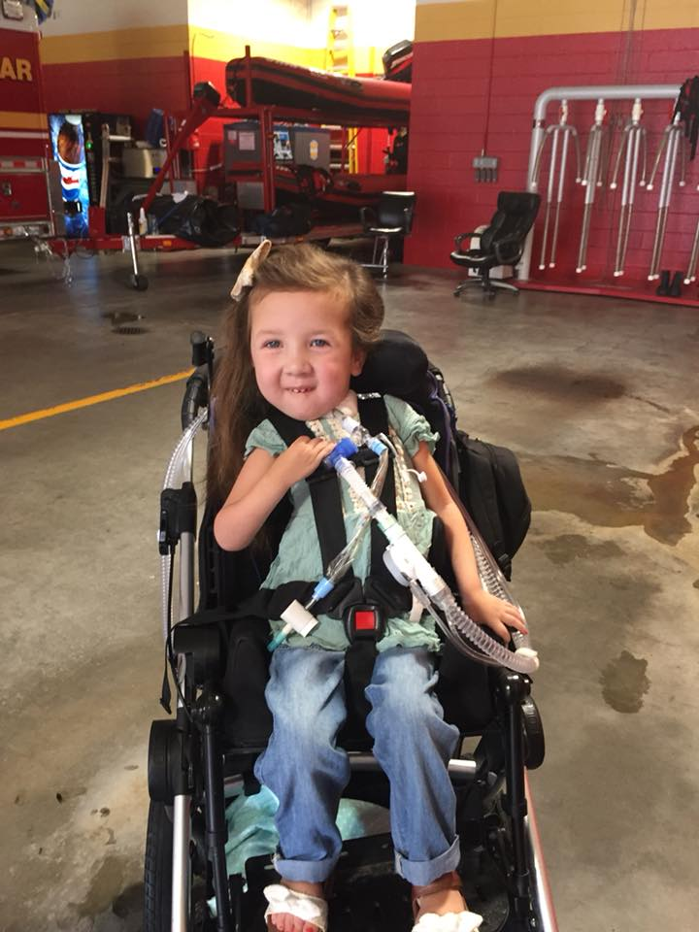

Lynchburg Fire Fighter’s Check Presentation Video
Notes:
You have helped bring new treatments forward.
Your efforts, your commitment, your dedication have all helped our kids with NMD.
You have put forth the hard work in the community to raise awareness of NMD.
You have put forth the hard work to raise money to advance the science and technology that are bringing to the forefront new innovative treatments for our patients with NMD.
You have put forth the hard work to help us for 65 incredible years.
And for this on your anniversary, we humbly say thank you.
You have help bring new treatments forward..

Slide 17
MDA Greater Virginia Contacts
Darcy Warren – dwarren@mdausa.org
Diane Boardman – dboardman@mdausa.org
Emily Withers – ewithers@mdausa.org
Notes:
You have helped bring new treatments forward.
Your efforts, your commitment, your dedication have all helped our kids with NMD.
You have put forth the hard work in the community to raise awareness of NMD.
You have put forth the hard work to raise money to advance the science and technology that are bringing to the forefront new innovative treatments for our patients with NMD.
You have put forth the hard work to help us for 65 incredible years.
And for this on your anniversary, we humbly say thank you.
You have help bring new treatments forward..

Slide 18
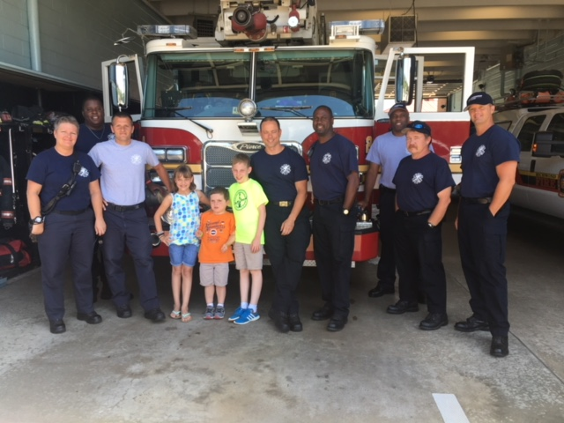
Notes:
You have helped bring new treatments forward.
Your efforts, your commitment, your dedication have all helped our kids with NMD.
You have put forth the hard work in the community to raise awareness of NMD.
You have put forth the hard work to raise money to advance the science and technology that are bringing to the forefront new innovative treatments for our patients with NMD.
You have put forth the hard work to help us for 65 incredible years.
And for this on your anniversary, we humbly say thank you.
You have help bring new treatments forward..

Slide 19
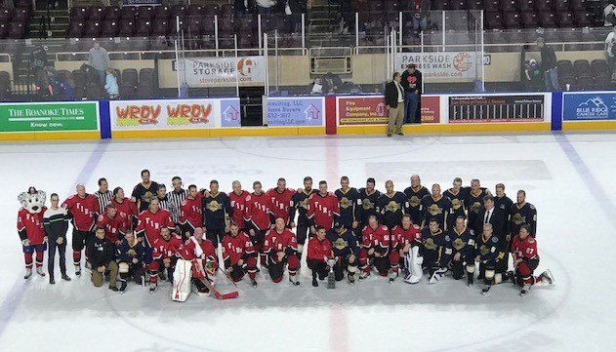
Notes:
You have helped bring new treatments forward.
Your efforts, your commitment, your dedication have all helped our kids with NMD.
You have put forth the hard work in the community to raise awareness of NMD.
You have put forth the hard work to raise money to advance the science and technology that are bringing to the forefront new innovative treatments for our patients with NMD.
You have put forth the hard work to help us for 65 incredible years.
And for this on your anniversary, we humbly say thank you.
You have help bring new treatments forward..

Slide 20
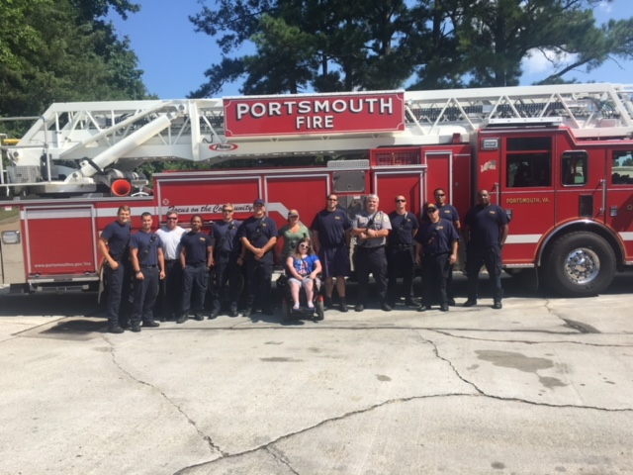
Notes:
You have helped bring new treatments forward.
Your efforts, your commitment, your dedication have all helped our kids with NMD.
You have put forth the hard work in the community to raise awareness of NMD.
You have put forth the hard work to raise money to advance the science and technology that are bringing to the forefront new innovative treatments for our patients with NMD.
You have put forth the hard work to help us for 65 incredible years.
And for this on your anniversary, we humbly say thank you.
You have help bring new treatments forward..

Slide 21
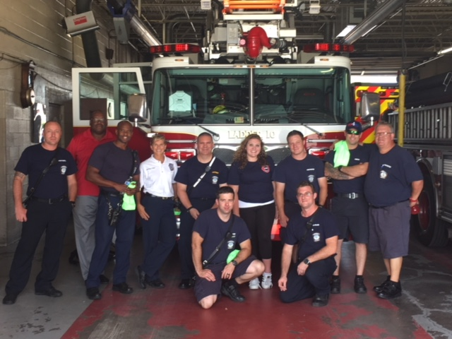
Notes:
You have helped bring new treatments forward.
Your efforts, your commitment, your dedication have all helped our kids with NMD.
You have put forth the hard work in the community to raise awareness of NMD.
You have put forth the hard work to raise money to advance the science and technology that are bringing to the forefront new innovative treatments for our patients with NMD.
You have put forth the hard work to help us for 65 incredible years.
And for this on your anniversary, we humbly say thank you.
You have help bring new treatments forward..

Slide 22
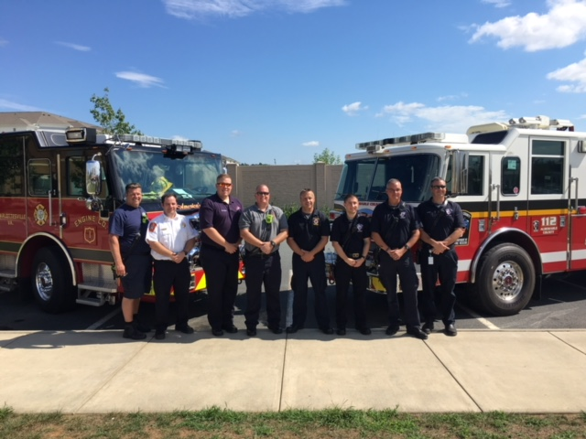
Notes:
You have helped bring new treatments forward.
Your efforts, your commitment, your dedication have all helped our kids with NMD.
You have put forth the hard work in the community to raise awareness of NMD.
You have put forth the hard work to raise money to advance the science and technology that are bringing to the forefront new innovative treatments for our patients with NMD.
You have put forth the hard work to help us for 65 incredible years.
And for this on your anniversary, we humbly say thank you.
You have help bring new treatments forward..

Slide 23
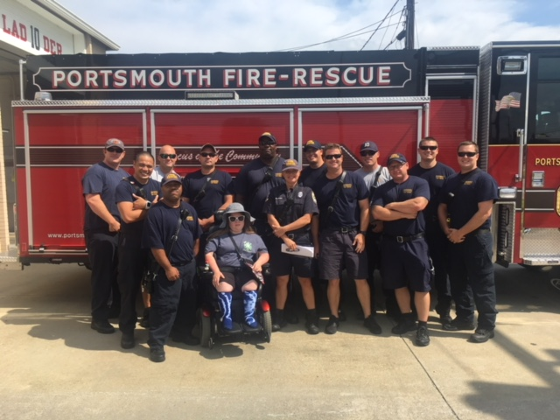
Notes:
You have helped bring new treatments forward.
Your efforts, your commitment, your dedication have all helped our kids with NMD.
You have put forth the hard work in the community to raise awareness of NMD.
You have put forth the hard work to raise money to advance the science and technology that are bringing to the forefront new innovative treatments for our patients with NMD.
You have put forth the hard work to help us for 65 incredible years.
And for this on your anniversary, we humbly say thank you.
You have help bring new treatments forward..

Slide 24

Notes:
You have helped bring new treatments forward.
Your efforts, your commitment, your dedication have all helped our kids with NMD.
You have put forth the hard work in the community to raise awareness of NMD.
You have put forth the hard work to raise money to advance the science and technology that are bringing to the forefront new innovative treatments for our patients with NMD.
You have put forth the hard work to help us for 65 incredible years.
And for this on your anniversary, we humbly say thank you.
You have help bring new treatments forward..

Slide 25
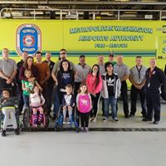
Notes:
You have helped bring new treatments forward.
Your efforts, your commitment, your dedication have all helped our kids with NMD.
You have put forth the hard work in the community to raise awareness of NMD.
You have put forth the hard work to raise money to advance the science and technology that are bringing to the forefront new innovative treatments for our patients with NMD.
You have put forth the hard work to help us for 65 incredible years.
And for this on your anniversary, we humbly say thank you.
You have help bring new treatments forward..

Slide 26
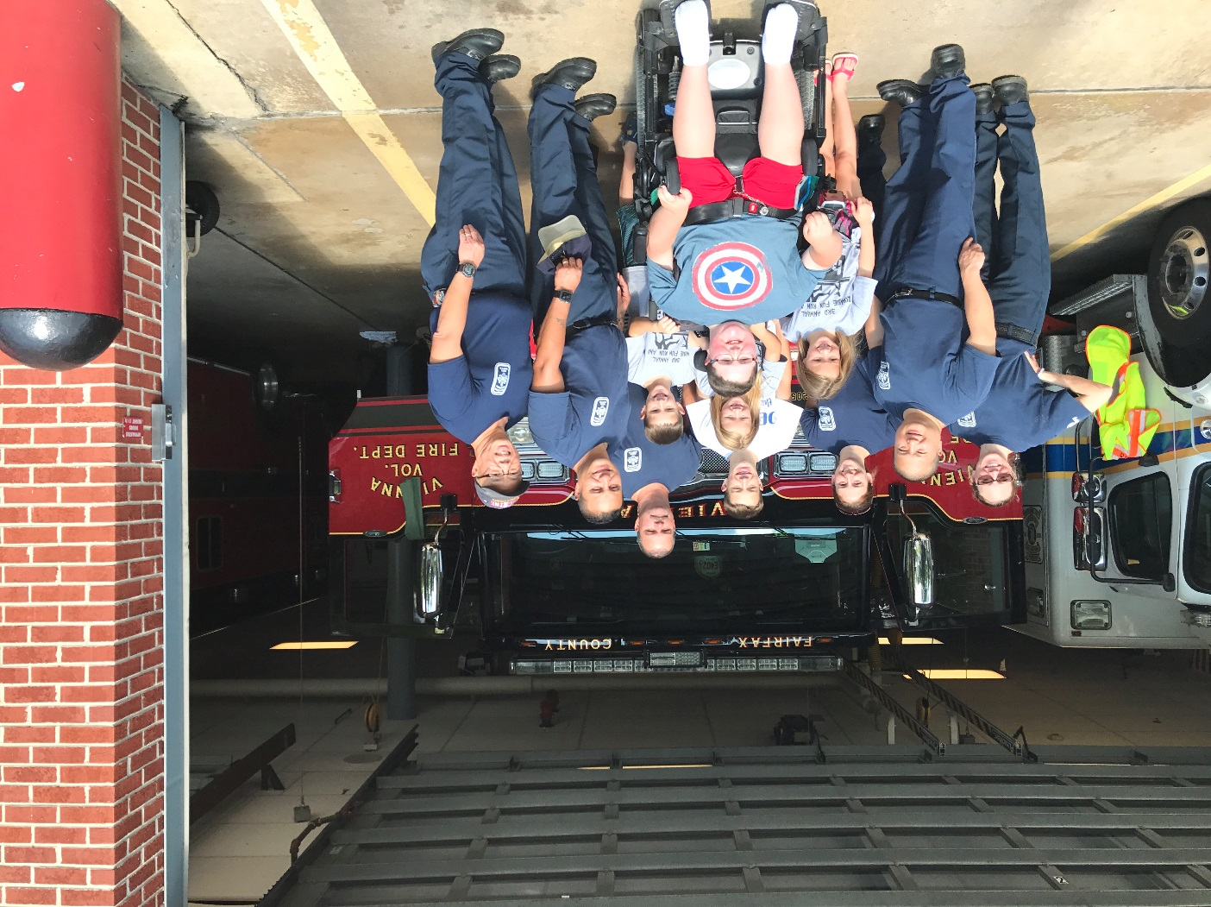
Notes:
You have helped bring new treatments forward.
Your efforts, your commitment, your dedication have all helped our kids with NMD.
You have put forth the hard work in the community to raise awareness of NMD.
You have put forth the hard work to raise money to advance the science and technology that are bringing to the forefront new innovative treatments for our patients with NMD.
You have put forth the hard work to help us for 65 incredible years.
And for this on your anniversary, we humbly say thank you.
You have help bring new treatments forward..

Slide 27
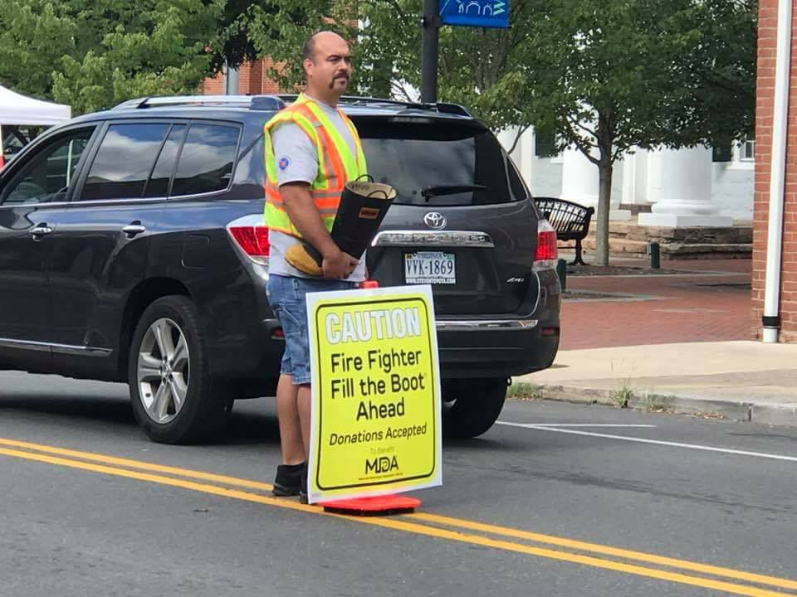
Notes:
You have helped bring new treatments forward.
Your efforts, your commitment, your dedication have all helped our kids with NMD.
You have put forth the hard work in the community to raise awareness of NMD.
You have put forth the hard work to raise money to advance the science and technology that are bringing to the forefront new innovative treatments for our patients with NMD.
You have put forth the hard work to help us for 65 incredible years.
And for this on your anniversary, we humbly say thank you.
You have help bring new treatments forward..

Slide 28
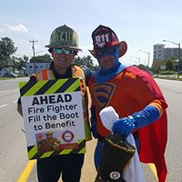
Notes:
You have helped bring new treatments forward.
Your efforts, your commitment, your dedication have all helped our kids with NMD.
You have put forth the hard work in the community to raise awareness of NMD.
You have put forth the hard work to raise money to advance the science and technology that are bringing to the forefront new innovative treatments for our patients with NMD.
You have put forth the hard work to help us for 65 incredible years.
And for this on your anniversary, we humbly say thank you.
You have help bring new treatments forward..

Slide 29
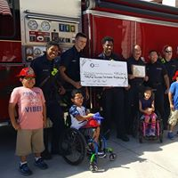
Notes:
You have helped bring new treatments forward.
Your efforts, your commitment, your dedication have all helped our kids with NMD.
You have put forth the hard work in the community to raise awareness of NMD.
You have put forth the hard work to raise money to advance the science and technology that are bringing to the forefront new innovative treatments for our patients with NMD.
You have put forth the hard work to help us for 65 incredible years.
And for this on your anniversary, we humbly say thank you.
You have help bring new treatments forward..

Slide 30
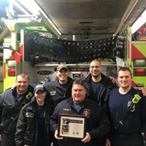
Notes:
You have helped bring new treatments forward.
Your efforts, your commitment, your dedication have all helped our kids with NMD.
You have put forth the hard work in the community to raise awareness of NMD.
You have put forth the hard work to raise money to advance the science and technology that are bringing to the forefront new innovative treatments for our patients with NMD.
You have put forth the hard work to help us for 65 incredible years.
And for this on your anniversary, we humbly say thank you.
You have help bring new treatments forward..

Slide 31
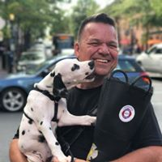
Notes:
You have helped bring new treatments forward.
Your efforts, your commitment, your dedication have all helped our kids with NMD.
You have put forth the hard work in the community to raise awareness of NMD.
You have put forth the hard work to raise money to advance the science and technology that are bringing to the forefront new innovative treatments for our patients with NMD.
You have put forth the hard work to help us for 65 incredible years.
And for this on your anniversary, we humbly say thank you.
You have help bring new treatments forward..

Slide 32
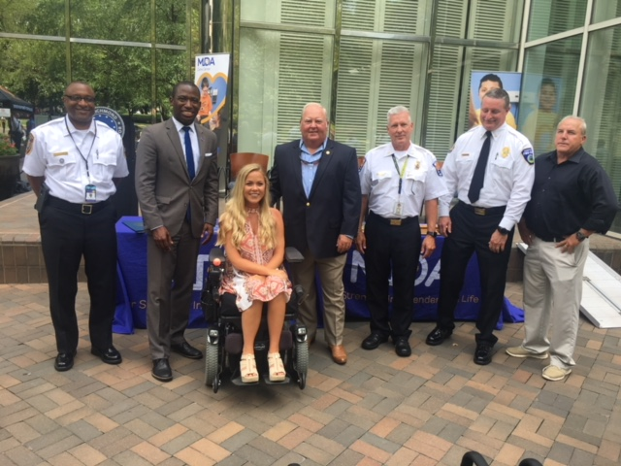
Notes:
You have helped bring new treatments forward.
Your efforts, your commitment, your dedication have all helped our kids with NMD.
You have put forth the hard work in the community to raise awareness of NMD.
You have put forth the hard work to raise money to advance the science and technology that are bringing to the forefront new innovative treatments for our patients with NMD.
You have put forth the hard work to help us for 65 incredible years.
And for this on your anniversary, we humbly say thank you.
You have help bring new treatments forward..

Slide 33
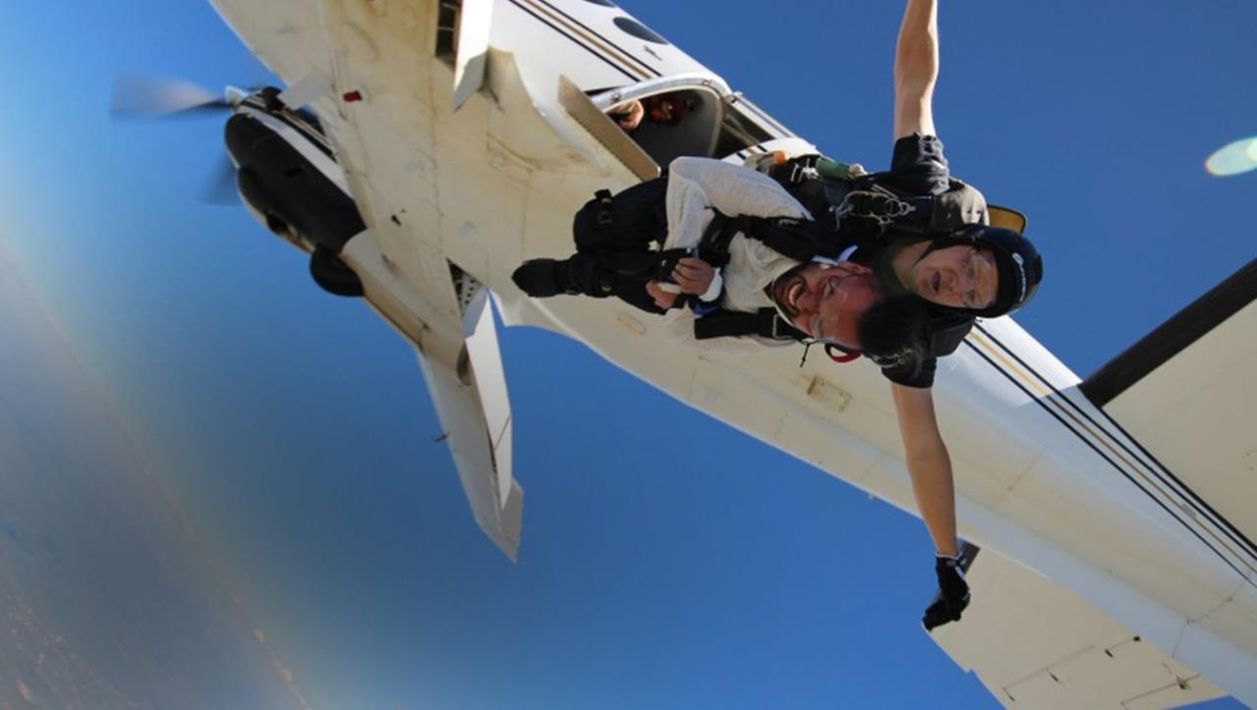

With your support, together we have brought these moments forward!
THANK YOU!
Notes:
Here’s to bringing more moments like this forward.
Thank you for your support and contribution.
To another 60 years strong.

